Slide 1
Emergency

Slide 2
If a tyre blows, what should you do?
Do NOT slam brakes immediately.
Control your steering wheel, steer right ahead and slowly stop.

Slide 3
If a rear wheel skid happens, what can you do?
Do NOT slam brakes immediately.
Turn your steering wheel in the direction of the skid, as the car straightens out, straighten the front wheels also.

Slide 4
If the acceleration pedal jams, what can should you do?
Turn off ignition and brake to a stop, leaving your car in gear.

Slide 5
In case other drivers are being reckless, what should you do?
Warn with your horn
Warn with your flashlights
Pull to the right as far as possible

Slide 6
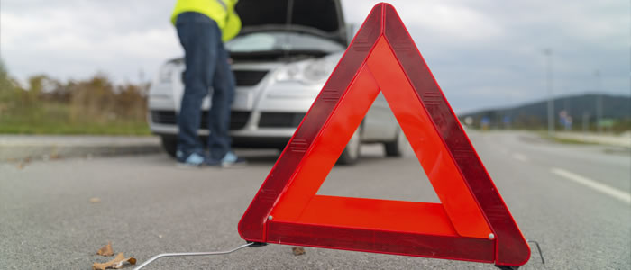
If your car breaks down, what should you do?
Get your car off the road
Flash the amber direction indicators
Place the red reflecting triangle 50 meters before your car

Slide 7
What if there is an accident on the road?
If there is no help: call for help or give first aid.
If there is help available: pass slowly and follow indications of police.

